Slide 1
ONLINE EXAM RANK LIST
INPUT SUTDENT SCORES

Slide 2
PRESENTED BY :
SHAIK RAHILL [24KB1A05JD]
SHAIK MOHAMMAD FAIZIL [24KB1A05HV]
DABBUGUNTLA RAVI KUMAR [24KB1A05KX]
SWARNA ANEEL [24KB1A05KG]
GUIDED BY :
Ashok Selva Kumar

Slide 3
INTRODUCTION :-
OBJECTIVE : to sort and rank the students based on their scores in descending order using bubble sort algorithm.
Bubble sort : bubble sort is a simple sorting algorithm , that works by repeatedly or by swapping adjacent elements.
Larger elements bubbled up to the end of the list.
WHY BUBBLE SORT ?
Simple to implement
Good for small data sets
Helps to understand the basic sorting concepts

Slide 4
UNDERSTANDING THE PROBLEM
Given a set of the students with their names and scores , the aim is to organize them from the highest to the lowest score.after sorting , the ranked list should clearly present each students name and score in order of their performance.

Slide 5
HOW THE GIVEN PROGRAM WORKS
Data structure :
A struct student name is used with two fields. A string of the students name, and a float of their scores. The structure helps to manage students data efficiently
SORTING PROCESS
The program receives input from student names and scores, and then apply bubble sorts to order them by score by highest to lowest.The sorted list is displays their ranked numbers

Slide 6
CODE COMPILES BASED ON
The program uses the following logic,
Define a struct student to store their name and score.
Prompt the user to enter the number of students , then input each students name and score
Implement the sort descending function, which compares and swap the scores to rank the students from highest to lowest.
Print the ranked list after sorting , showing names and scores in order
The implementation demonstrates the data input struct utilization , and the bubblesort process in C

Slide 7
SAMPLE OUT PUT
HERE is an example demonsratingthe programs usage :
User input:
Enter the number of students : 3
Enter the the name of the student 1 : arun
Enter the score of the arun : 44
Enter the name of th student 2 : kamal
Enter the score of the kamal : 55
Enter the name of the student 3 : Daniel
Enter the score of the Daniel “: 33

Slide 8
Their out put
RANK :
RANK 1 : KAMAL – 55
RANK 2 : ARUN - 44
RANK 3 : DANIEL -33

Slide 9
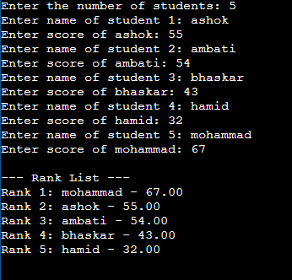
SOIRCE CODE OUT PUT :

Slide 10
ADVANTAGES OF BUBBLE SORT
SIMPLICITY :
Bubble sort is exponentially easy to grasp and implement, making it a preferred teaching tool for introducing sorting tools
IN PLACE AND STABLE :
IT doesn’t required additional memory to sort the elements, and preserves the relative order of students with equal scores.

Slide 11
CONCLUSION
In summary bubble sort offers a clear a straight foreward way to rank students by their scores, serving as an educarional example in C . How ever a large data sets , more algorithms are recommended. Understanding the sorting principles , remains a key skill for programming an algorithm development.

Slide 12
THANK YOU !!

